Slide 1


A REPORTING and COMPARING APPLICATION FOR PROVINCE BASED COVID-19 CASES IN TURKEY WITH R SHINY
Ph.D. Cenk İÇÖZ
Eskişehir Technical University
Department of Statistics
Eskişehir, Turkey
24-26 Nov 2021

Slide 2
Motivation
Insufficient covid data sharing for comparison of province based weekly cases. (only weekly cases)
No database for all weekly data (officially!!!)
Therefore, missing reporting of comparisons time-wise and spatio-temporal wise in the official site. https://covid19.saglik.gov.tr/
Let’s build an app. for use of everyone (esp. people without coding knowledge )
Observing the effects of normalization procedure in Turkey.
Boredom from quarantine ☺

Slide 3

Covid -19 Pandemic in Turkey
Partial lockdown applications
Mask, social distancing, hygiene
Online Education ( primary schools to universities )
Provincial Risk based normalization procedures: Late Feb 2021
14th April partial lockdown
29th April to 17th May full lockdown: Education suspended all exams postponed.

Slide 4
Covid -19 Visualizations
Thematic Maps (Spatial dimension)
Line Graphs (Time series graphs)
Bar Graphs
Interactive Graphs
Dashboards
Shiny Applications [1,2]

Slide 5
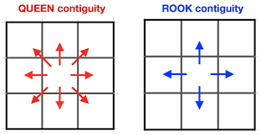
Covid -19 Visualizations
Why spatial neighbors?
Circulation between cities
Similar weather properties
Similar socio-economic properties

Slide 6
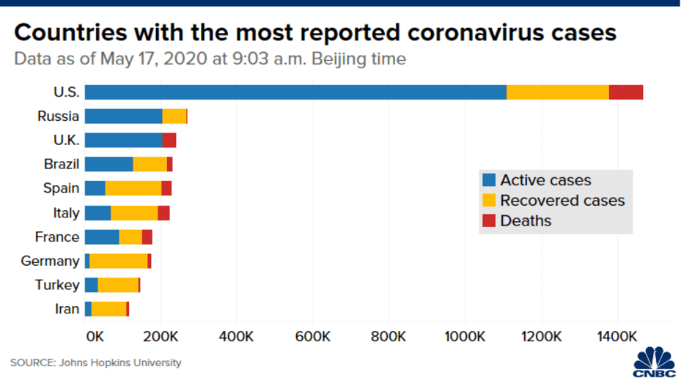
Covid -19 Visualizations

Slide 7
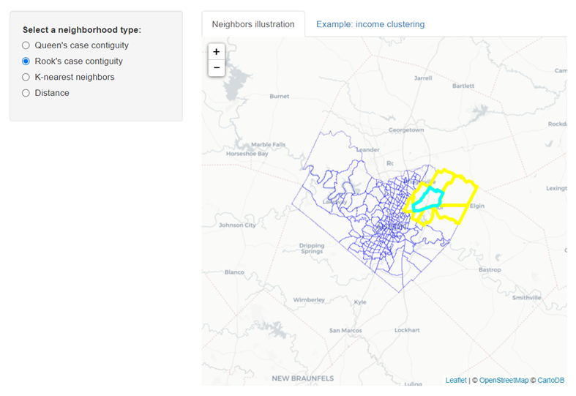
Application and Dashboard Ex.
[3]

Slide 8
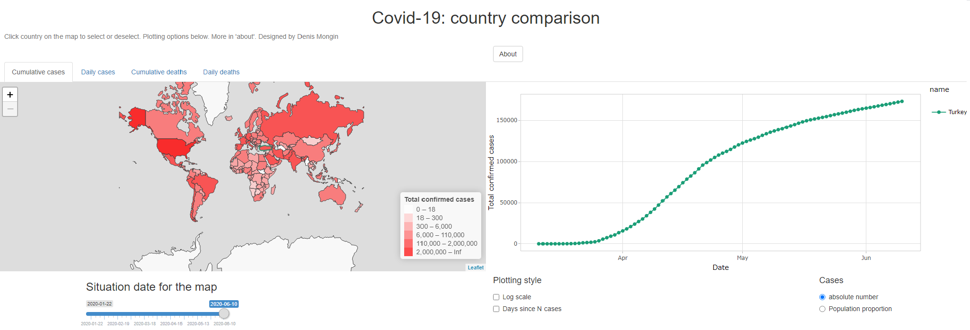
Application and Dashboard Ex.
Covid-19 Country Comparison. https://scitilab.shinyapps.io/Covid19/

Slide 9
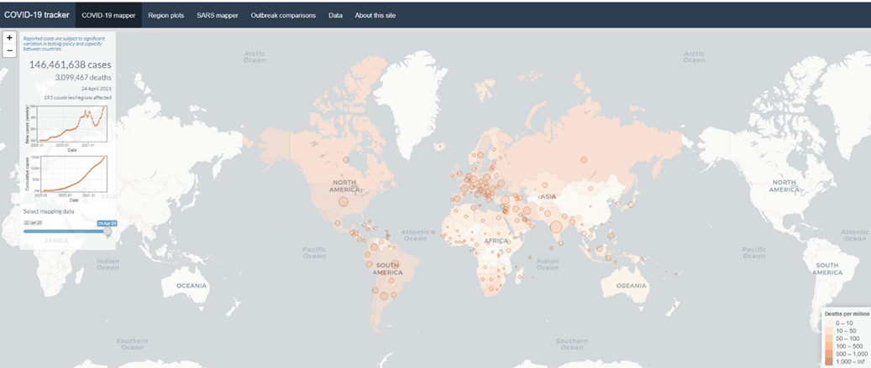
Application and Dashboard Ex.
Covid -19 Tracker. https://shiny.rstudio.com/gallery/covid19-tracker.html

Slide 10
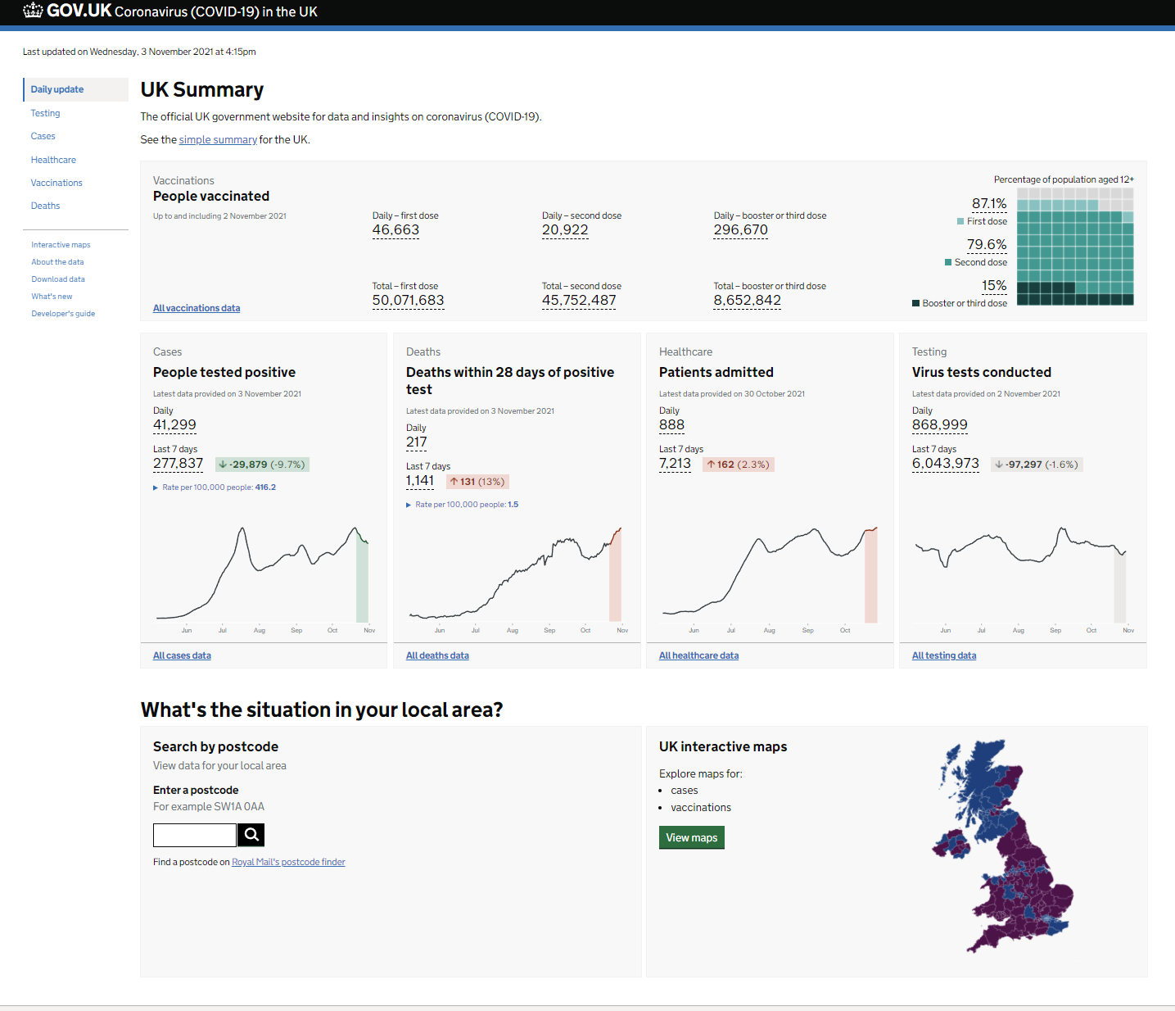
Application and Dashboard Ex.
Daily summary: Coranavirus in the UK. https://coronavirus.data.gov.uk/

Slide 11
Shiny Application
Used Packages
tmap
shiny
sp
spdep (for investigating neighbor based case trends)
ggplot2
plotly

Slide 12
Shiny Application
Parts of the app. ( tabs )
Introduction
Province Based Risk Classification Comparison for Two weeks' Cases
Increase-decrease Status and Increase-Decrease Percentages
Province and it's Neighbours Weekly Trends

Slide 13
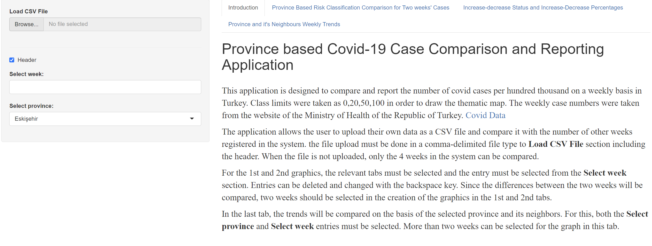
Shiny Application

Slide 14
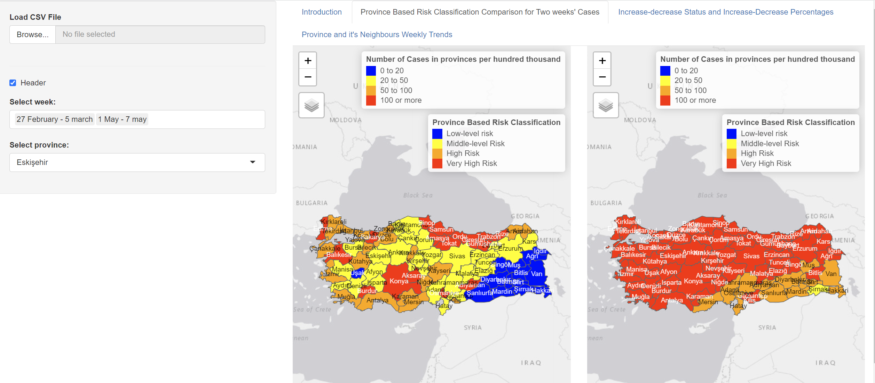
Shiny Application

Slide 15
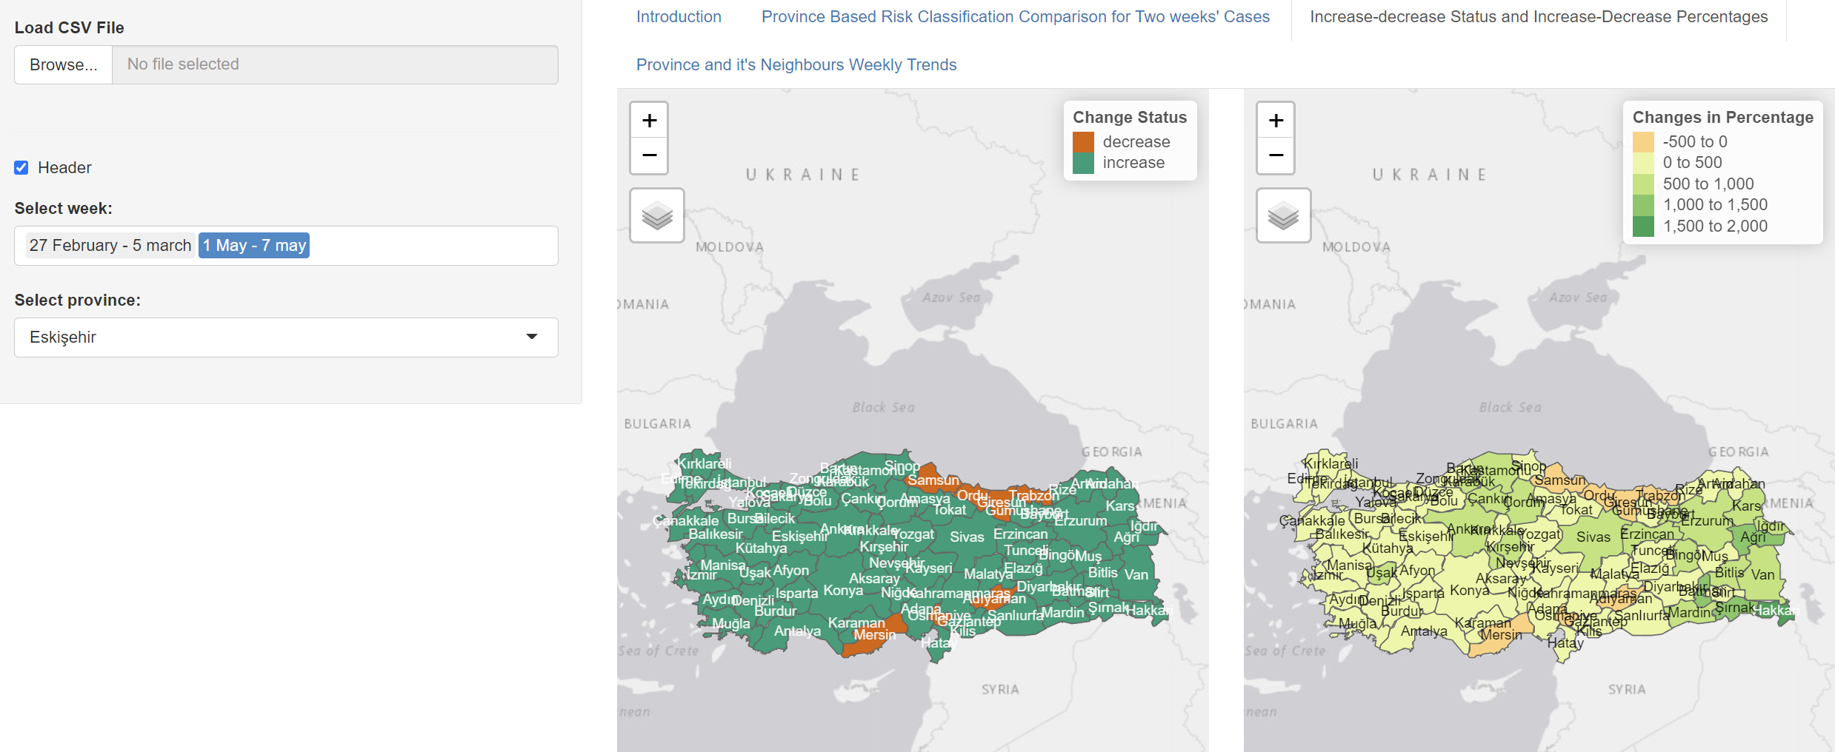
Shiny Application

Slide 16
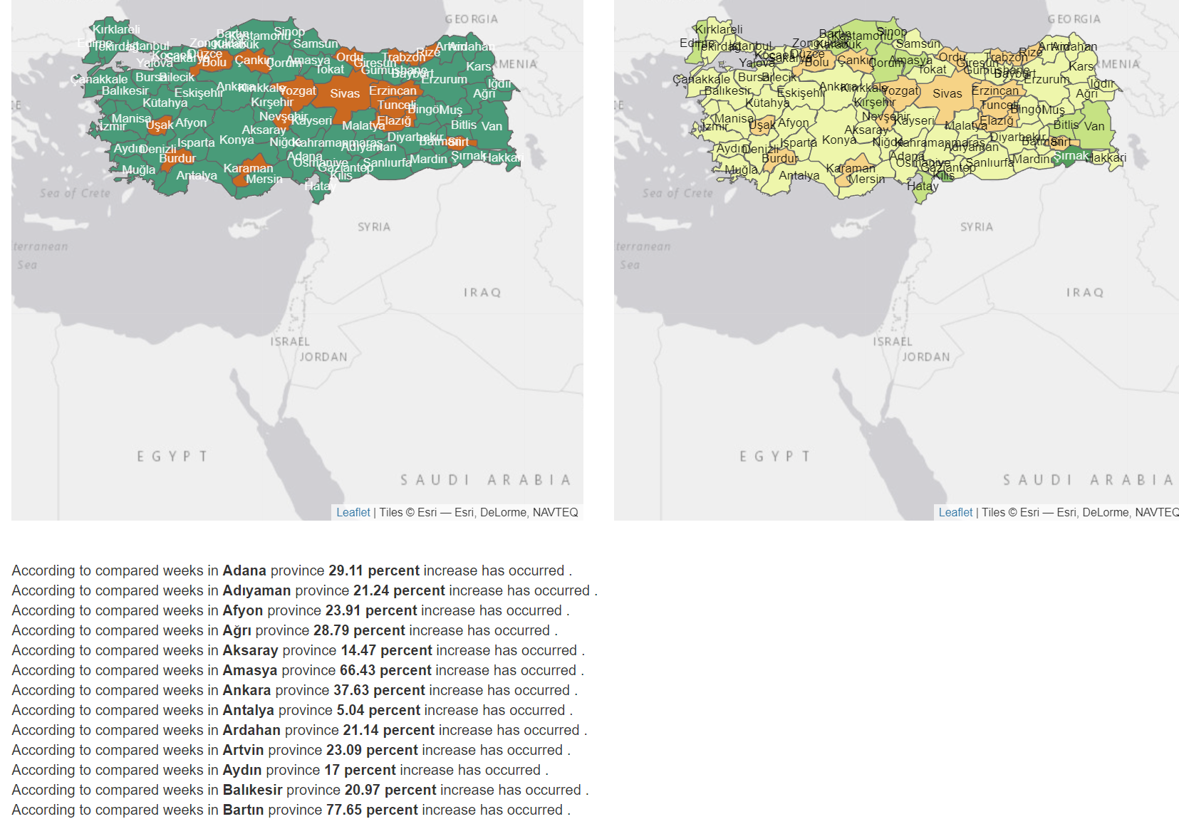
Shiny Application

Slide 17
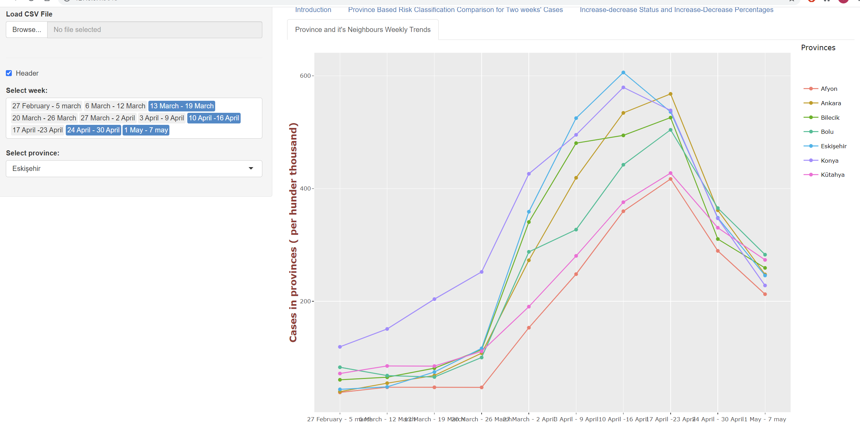
Shiny Application

Slide 18
Improvements
Multilanguage app. Design
Web scraping?
Data table
Selection of provinces by users.
Multiple thematic maps ( Ex: 4 weeks at most)
Risk based
Choropleth map

Slide 19
References
[1]Towards Data Science: “Top 100 R resources on Novel COVID-19 Coronavirus”. https://towardsdatascience.com/top-5-r-resources-on-covid-19-coronavirus-1d4c8df6d85f
[2] Covid 19-r. https://mine-cetinkaya-rundel.github.io/covid19-r/ (05.05.2021).
[3] Spatial neighbors in R - an interactive illustration. http://personal.tcu.edu/kylewalker/spatial-neighbors-in-r.html (05.05.2021).
[4]https://covid19.saglik.gov.tr/
[5] https://dergipark.org.tr/en/pub/veri/issue/64538/934799

Slide 20
Thank you. Questions?
Contact: cicoz@eskisehir.edu.tr
Github:
https://github.com/cenkicoz26/covid
Shiny App Turkish Version:
https://cenkicoz.shinyapps.io/covidshiny/?_ga=2.108085440.338756453.1619906678-857120237.1618862014

